Slide 1
Bellabeat & Beyond! Wellness Technology Apps & Their Influence
A guide by Delano Taylor

Slide 2
Overview
By observing consumer data from non-Bellabeat products, we can reveal opportunities for growth in the market.
Smart device usage indicates that understanding current habits leads to making healthy decisions.
Analysis of Fitbit data. Data collected includes physical activity, heart rate, and sleep monitoring. Data was collected via daily activity and step counting.
Conclude that there is more than enough room for growth in the smart device market. Using a smart device leads to an overall healthier lifestyle and mindset.

Slide 3
Bellabeat
Bellabeat is a high-tech company that manufactures health-focused smart products. Collecting data on activity, sleep, stress, and reproductive health has allowed Bellabeat to empower women with knowledge about their own health and habits. Since it was founded in 2013, Bellabeat has grown rapidly and quickly positioned itself as a tech-driven wellness company for women. By studying the consumer data of non-Bellabeat products, we can reveal more opportunities for growth. Understanding how consumers use smart products, and the impact it has on their wellness, we can move forward with more aggressive marketing strategies.

Slide 4
Data Sources, Manipulations, Discoveries
For starters, I accessed the Fitbit dataset (https://www.kaggle.com/arashnic/fitbit).
Because of the size, I decided SQL would be the easiest way to access all the data at once. SQL gave errors to two of the datasets (date formats), but I was able to fix them by splitting the column (Text to column).
After creating my tables in the dataset and looking over the data, I noticed that almost all metrics collected by Fitbit tracked higher than the national average.

Slide 5
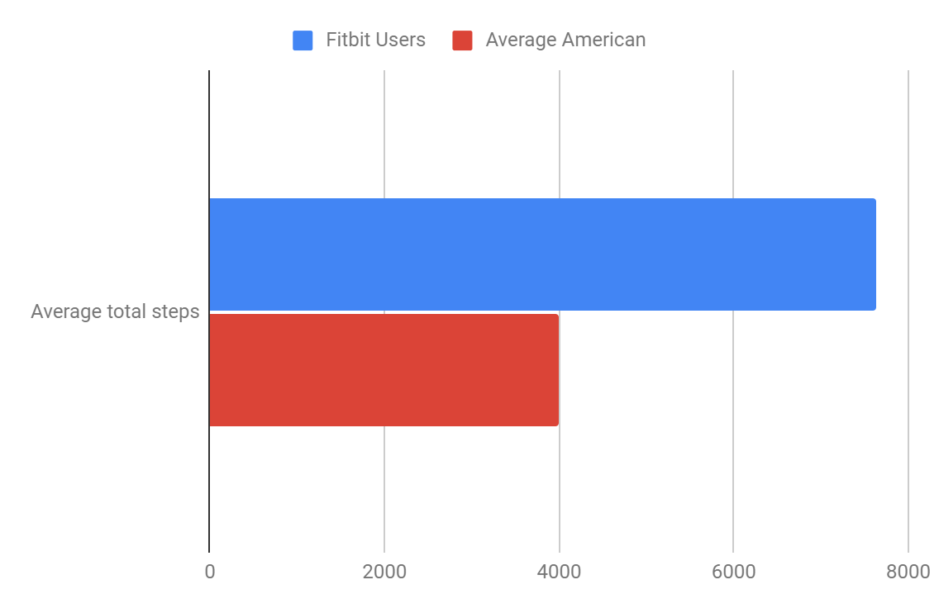
Average Step Count of Fitbit Users:
When compared to the national average of steps taken per day, we see that Fitbit users are well over the average. With the average falling between 3,000-4,000 steps a day, Fitbit users are clocking in right around 7,638 steps per day. That’s about 5.49 miles a day!
(https://www.mayoclinic.org/healthy-lifestyle/fitness/in-depth/10000-steps/art-20317391)

Slide 6
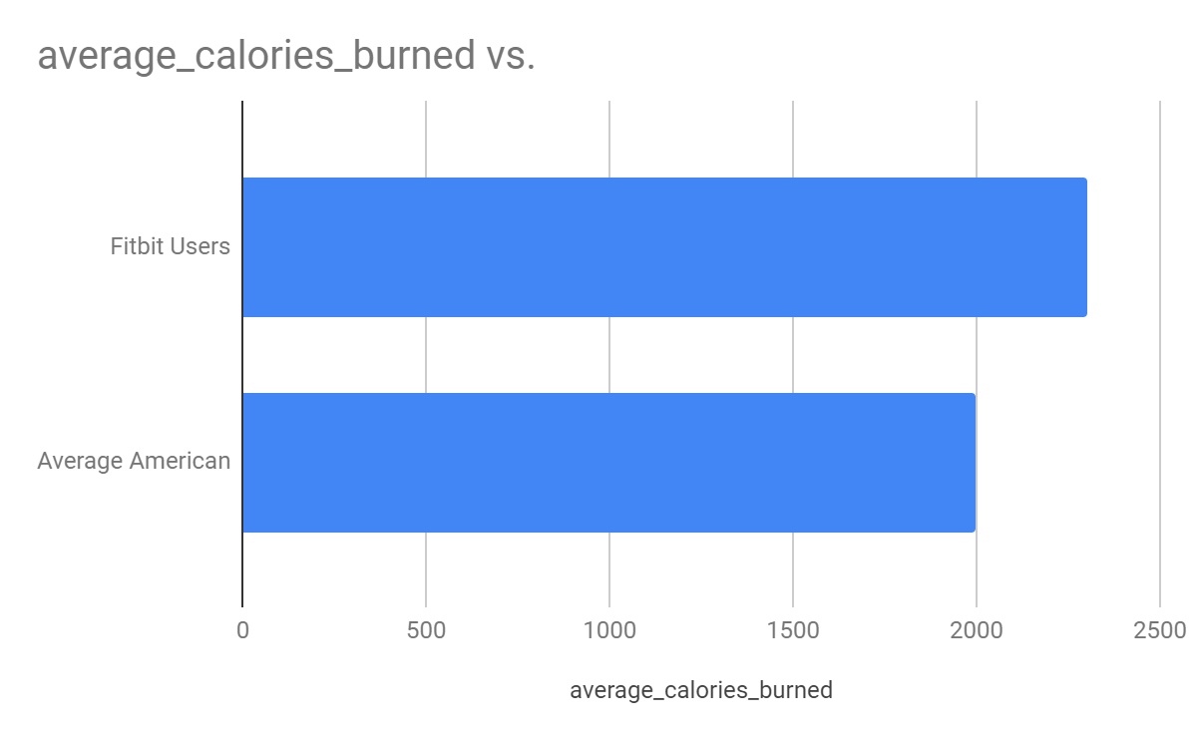
Average Calories Burned by Fitbit Users:
When compared to the national average of calories burned per day, we see that Fitbit users are well over the average in this category as well. With the average falling between 2,000 calories a day, Fitbit users are averaging 2,304 calories burned per day.

Slide 7
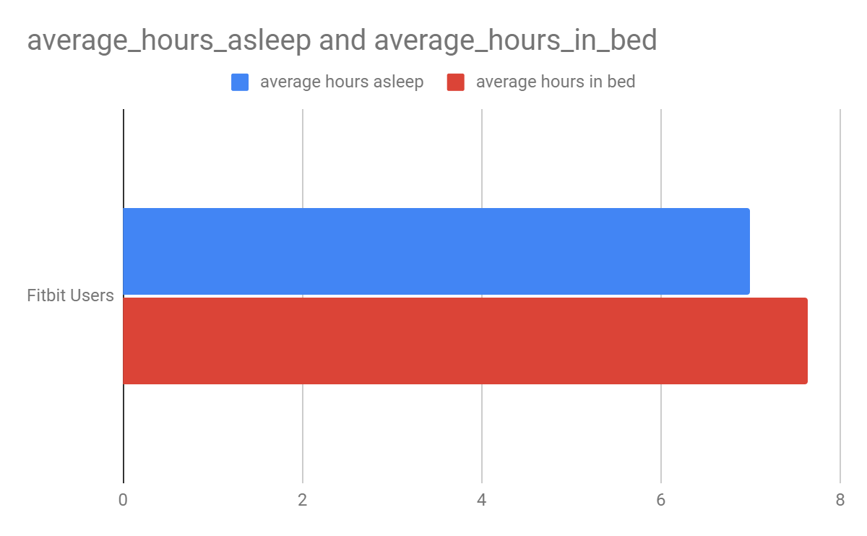
Catching Zzz’s After All the Activity:
It’s only natural to want to call it an early night after a day of running around! On average we get about 6.8 hours of sleep a day, although 7 hours or more are recommended. Fitbit users get roughly 6.9 hours of sleep and spend an average of 7.64 hours in bed each night. What a well rested bunch!
https://news.gallup.com/poll/166553/less-recommended-amount-sleep.aspx

Slide 8
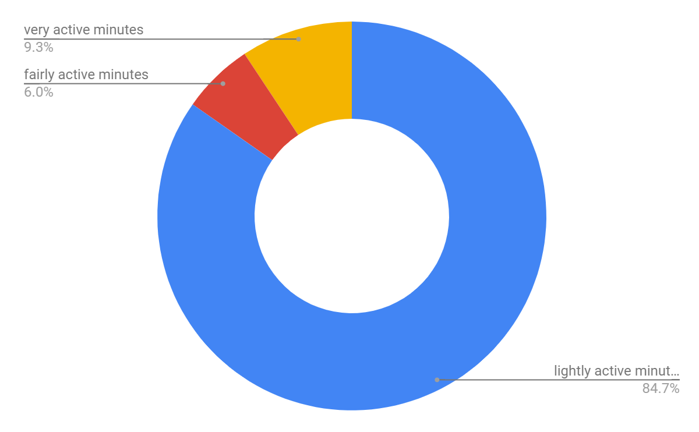
Not All Activity Is Alike
Not all users are built the same! Some users move at a different pace. In my analysis, I discovered that some users prefer a light or medium workout, compared to something more intense. Motion is motion and it’s all encouraged! Take a look at the breakdown of minutes users spend exercising on average.

Slide 9
Bellabeat & Beyond!
Based on the success of the Fitbit, I conclude that there is plenty of opportunity in the smart device market. We can deduce that understanding current habits can lead to healthier decision making. We also saw that Fitbit users spend more time in bed, which is a big part of wellness! Also, Fitbit users are diverse! As a smart watch user myself, I like the style and function of it. We have to rethink the term active when it comes to our users!

Slide 10
What’s Next?
With a renewed focus on our social media marketing and expanding our demographic, I predict great things for Bellabeat! Making our brand as inclusive as possible can bolster our sales. Also, touting the positive influences wellness apps have in our lives would be a strong lead. The data supports it! By monitoring your activity, sleep, and stress levels, you can stay ahead of the game when it comes to physical and mental wellness!

Slide 11
Sources:
https://www.kaggle.com/arashnic/fitbit
https://www.mayoclinic.org/healthy-lifestyle/fitness/in-depth/10000-steps/art-20317391
https://news.gallup.com/poll/166553/less-recommended-amount-sleep.aspx

